Slide 1
Vaping
Jessica Ryall-Spoor
Senior Officer – Community Protection and Health
Public Protection Partnership

Slide 2
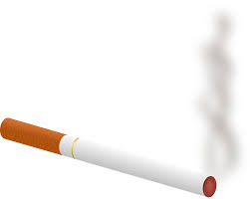
Vaping through the years
25 years ago
Quit aid for smokers
7 years ago, popularity grew
Introduction of single use vapes – colours, flavours
Last 3 years increase in children using vapes – are vapes being marketed at children?

Slide 3
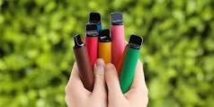
What are vapes
Pod-based devices with single-use plastic cartridge
Contain Lithium Ion batteries
Up to 2 ml of liquid
Up to 20mg (2%) nicotine
Up to 600 ‘puffs’ - equivalent of 30 cigarettes

Slide 4
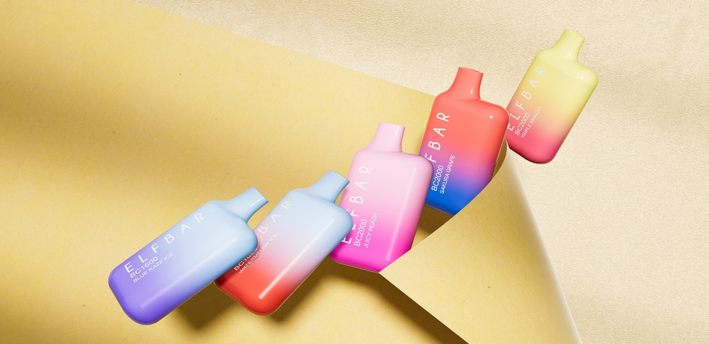
Vapes and the law
At what age can you legally buy a vape?
What ID can you use?

Slide 5
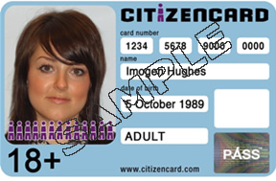
Answers
18 years of age
Proof of age
Driving Licence
Passport
Pass card. Government-approved PASS (Proof of Age Standards Scheme) Accredited

Slide 6
How do children get vapes?
Buy them themselves
Get an older friend to buy them – Proxy selling
Given them by friends/ relatives
Steal them from friends/ relatives

Slide 7
Test Purchasing
Under 18
Vape seizure
Trading Standards and Police
Retail premises
Investigate
Warning
Education
Prosecution

Slide 8
How Many Vapes in a Month?

Slide 9
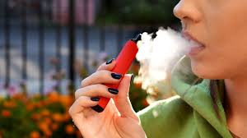
How many vapes in a month Facts
43 Vapes
£215
25,800 ‘puffs’
1,290 cigarettes

Slide 10
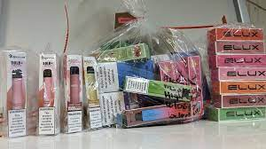
Illegal Vapes
Unregulated
12% nicotine
12,000 ‘puffs’
Can contain other substances
Fire hazard

Slide 11
Vaping and health
Don’t contain tobacco or other chemicals found in cigarettes
Contain nicotine which is addictive
Quit aid for smokers
Health risks largely unknown
Asthma suffers can be affected
If you don’t smoke, don’t vape!
If you are under 18 don’t vape!

Slide 12
Why do children vape?

Slide 13
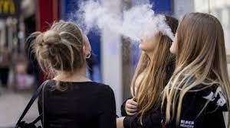
Why do children vape?
To relieve stress or anxiety
Boredom
Just to try
To fit in with others
Addicted to nicotine

Slide 14
What could the Government do to prevent children from vaping?

Slide 15
Smoke Free Generation
Anyone born after on or after 1st January 2009 will never legally be able to smoke or vape
Restriction on flavours
Vapes kept out of sight
Regulate packaging
Restrictions on disposable vapes
Increase tax on vapes

Slide 16
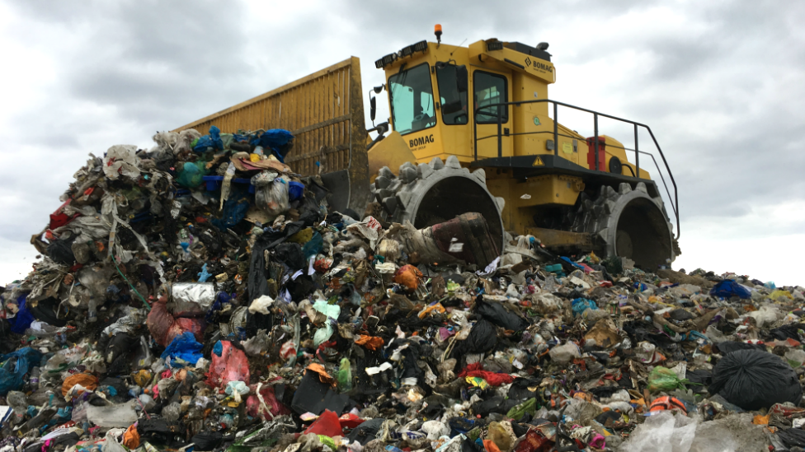
Vaping and the environment
5 million single use vapes are thrown away each week
Less than 20% of ‘vapers’ recycle single use vapes
Incorrect disposal can release plastic, electronical and hazardous chemical waste into the environment
Disposable vapes contain critical materials such as lithium and copper
Amount of lithium and copper discarded in disposable vapes in the UK every year is enough to power nearly 5,000
electric vehicles

Slide 17
Many Thanks
Any questions?
My contact details:
jessica.ryall-spoor@westberks.gov.uk

